Slide 1
Money porter
Md. Ahsan Nayem
Id: 19-41212-2
Dept. of CSE American International University-Bangladesh

Slide 2
Objective
Basically money porter is an online mobile banking system. The ultimate objective of money porter is to ensure fast and secure financial services for the people of Bangladesh. It has a special focus to serve the masses people of the country to achieve financial inclusion by providing services that are convenient, affordable and reliable .

Slide 3
user
Merchandiser
User
Agent
Personal user
Admin

Slide 4
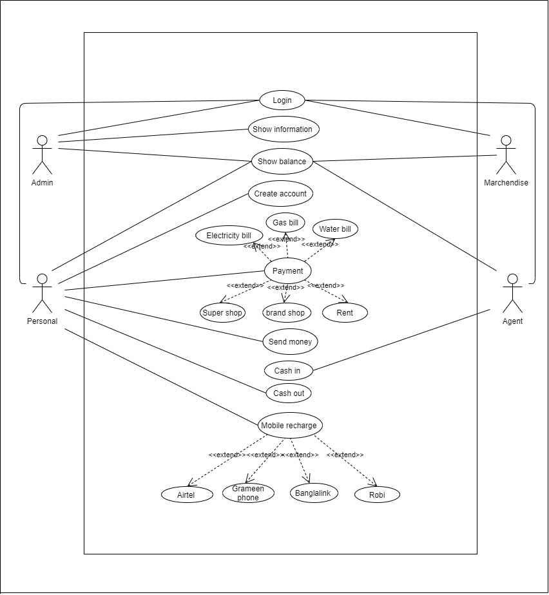
use case diagram

Slide 5
Functionalities
Admin: an admin can log in, log out , insert, delete, update user information and show account information and transection history of user. But Admin can not change user mobile number
Personal user : a personal user can login, log out, change password, recharge, send money, pay bill , show transection history and cash out. Cash out is valid for only agent number and pay bill is valid for merchandiser number.
Agent: an agent can login, logout, pay bill, cash out, change password, show transection history and cash in. Cash out is valid for only admin number and pay bill is valid for merchandiser number.
merchandiser: merchandiser is a payment receiver who can receive payment, login, cash out, log out, show transection history, change password and show balance. Cash out is valid for only admin number

Slide 6
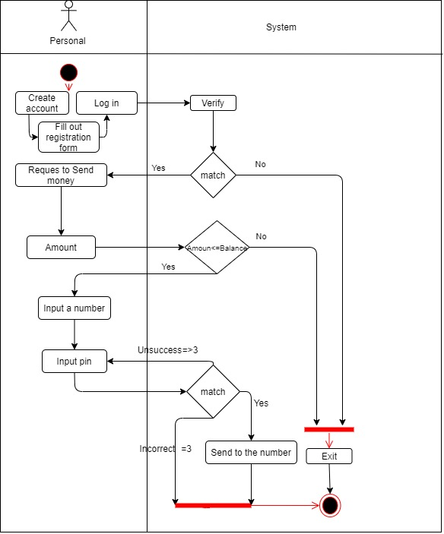
Send money

Slide 7
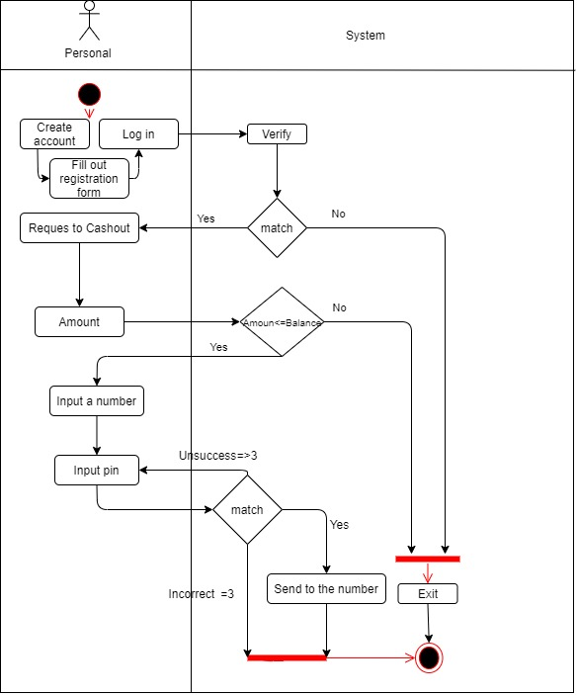
Cash out

Slide 8
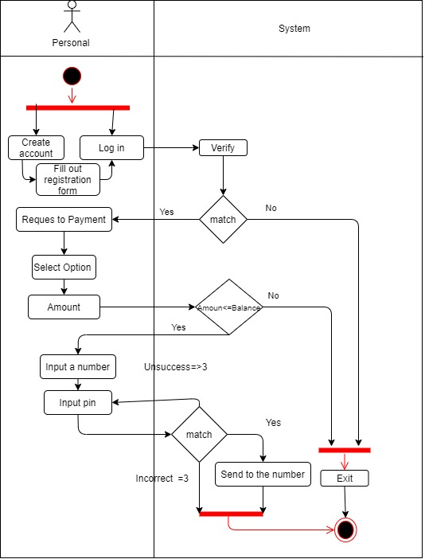
payment

Slide 9
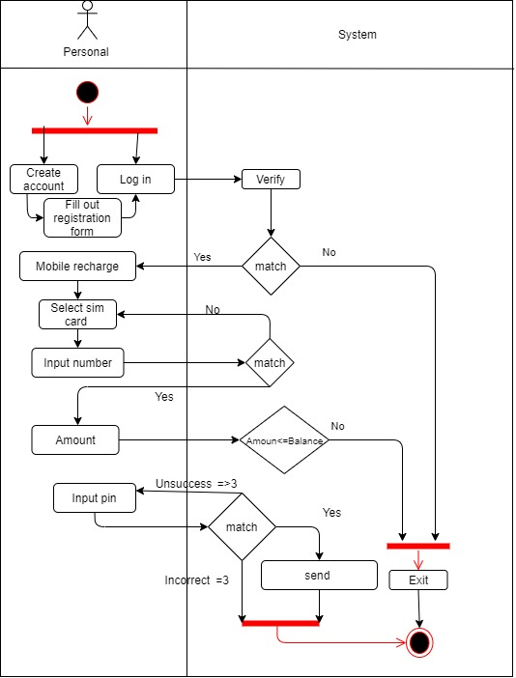
Mobile recharge

Slide 10
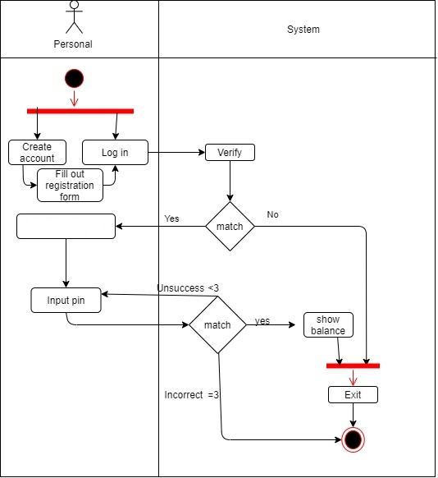
Show balance
Show balance

Slide 11
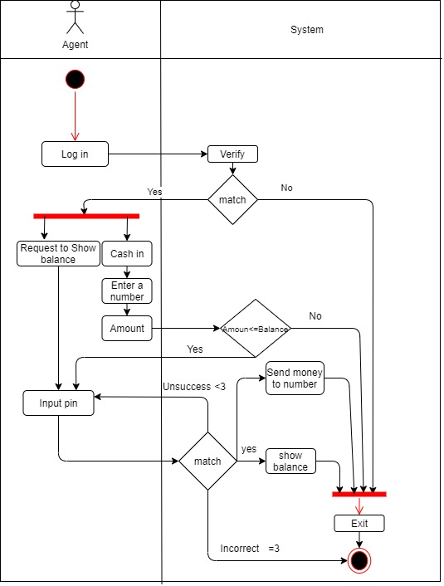
agent

Slide 12
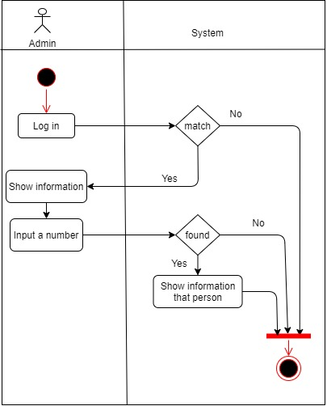
admin

Slide 13
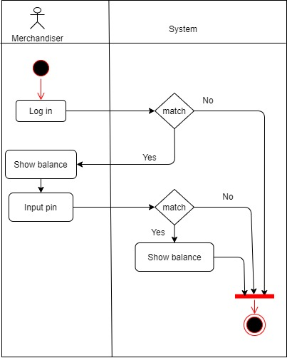
merchandiser

Slide 14
features
FEATURE | ACCESS | FEATURE | ACCESS
Log in | ALL | LOG OUT | ALL
Mobile recharge | PERSONAL USER | Pay bill | PERSONAL USER AND AGENT
Forgot password | PERSONAL USER,MERCHANDISER, AGENT | Cash out | PERSONAL USER,MERCHANDISER, AGENT
Create account | ALL | Update | ADMIN
Send money | PERSONAL USER AND AGENT | Delete | ADMIN
Cash In | AGENT | Show transection history | ALL
INSERT | ADMIN | RESET | ADMIN

Slide 15
LIMITATION
As this is a demo project it is not connect it with any bank ,mobile phone operator or institute so basically it can not transection .
Initially it does not contain any transection limitation
Basically it can transect only one currency
User can not import money from bank account

Slide 16
Thank you

